Slide 1
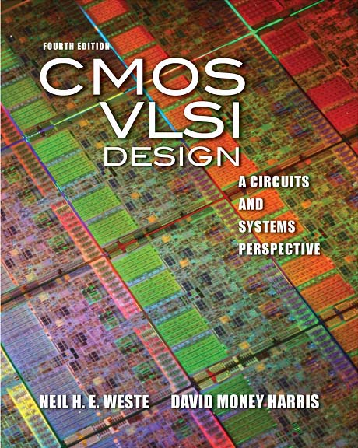
Lecture 1: Circuits & Layout

Slide 2
Outline
A Brief History
CMOS Gate Design
Pass Transistors
CMOS Latches & Flip-Flops
Standard Cell Layouts
Stick Diagrams

Slide 3
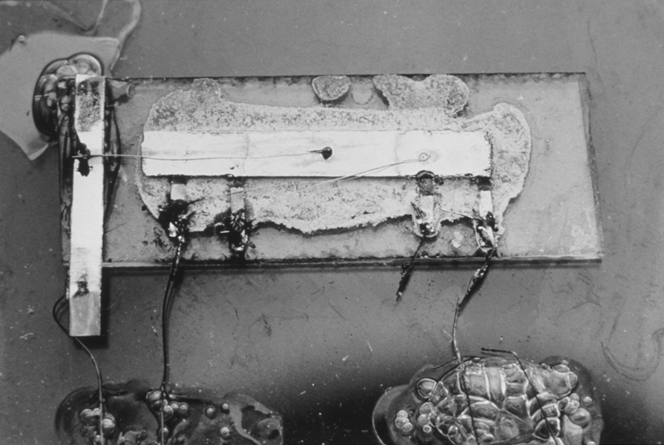
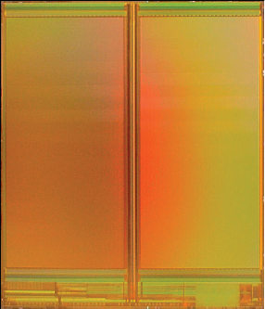
A Brief History
1958: First integrated circuit
Flip-flop using two transistors
Built by Jack Kilby at Texas Instruments
2010
Intel Core i7 μprocessor
2.3 billion transistors
64 Gb Flash memory
> 16 billion transistors
Courtesy Texas Instruments
[Trinh09]
© 2009 IEEE

Slide 4
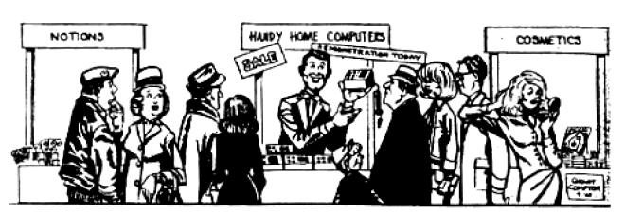
Growth Rate
53% compound annual growth rate over 50 years
No other technology has grown so fast so long
Driven by miniaturization of transistors
Smaller is cheaper, faster, lower in power!
Revolutionary effects on society
[Moore65]
Electronics Magazine

Slide 5
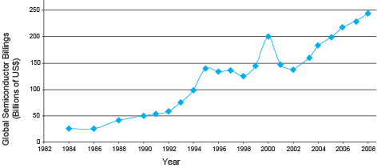
Annual Sales
>10¹⁹ transistors manufactured in 2008
1 billion for every human on the planet

Slide 6
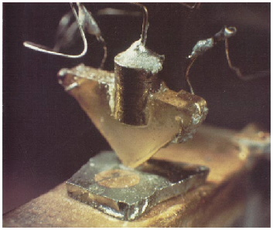
Invention of the Transistor
Vacuum tubes ruled in first half of 20th century Large, expensive, power-hungry, unreliable
1947: first point contact transistor
John Bardeen and Walter Brattain at Bell Labs
See Crystal Fire
by Riordan, Hoddeson
AT&T Archives. Reprinted with permission.
Notes:
Bóng chân không phổ biến ở nữa đầu thế kỷ 20

Slide 7
Transistor Types
Bipolar transistors
npn or pnp silicon structure
Small current into very thin base layer controls large currents between emitter and collector
Base currents limit integration density
Metal Oxide Semiconductor Field Effect Transistors
nMOS and pMOS MOSFETS
Voltage applied to insulated gate controls current between source and drain
Low power allows very high integration

Slide 8
 | BJT | MOSFET
Phân loại | NPN, PNP | NMOS, PMOS
Cực | E, B, C | S, D, G
Điện trở đầu vào và cách ĐK | Nhỏ, dòng I | Lớn, áp V
Nhiệt độ và ổn định | Tốt | Kém
Tần số | Thấp, trung bình | Cao
Ứng dụng | Mạch khuếch đại | Vi xử lý

Slide 9
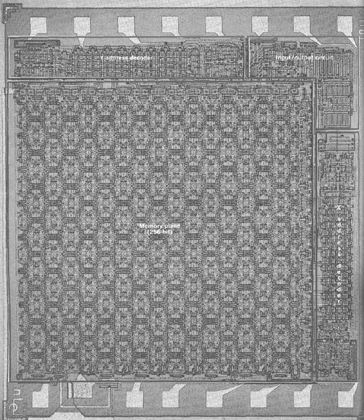
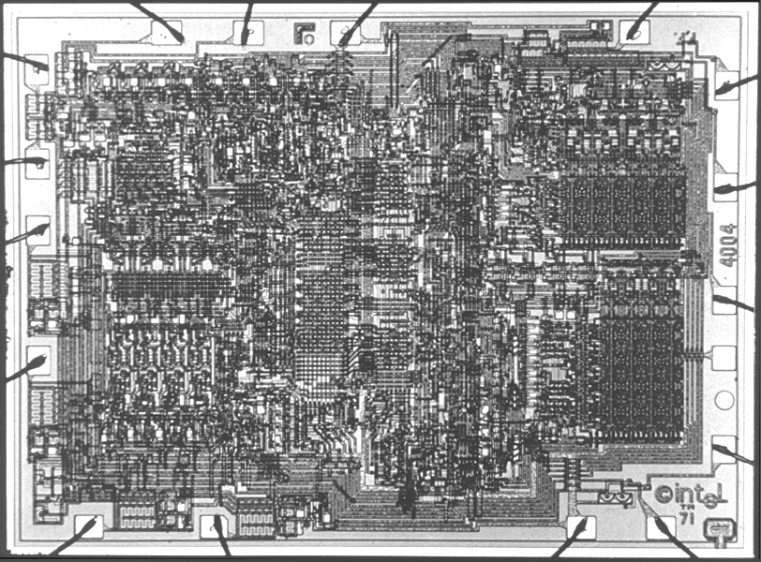
MOS Integrated Circuits
1970’s processes usually had only nMOS transistors
Inexpensive, but consume power while idle
1980s-present: CMOS processes for low idle power
Intel Museum.
Reprinted with permission.
[Vadasz69]
© 1969 IEEE.
Intel 1101 256-bit SRAM
Intel 4004 4-bit μProc

Slide 10
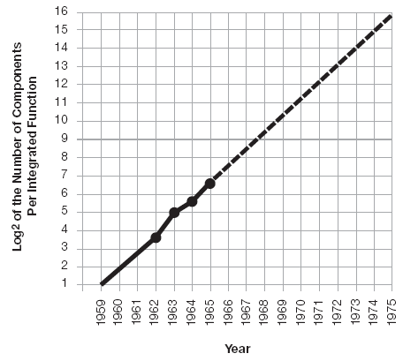
Moore’s Law: Then
1965: Gordon Moore plotted transistor on each chip
Fit straight line on semilog scale
Transistor counts have doubled every 26 months
Integration Levels
SSI: 10 gates
MSI: 1000 gates
LSI: 10,000 gates
VLSI: > 10k gates
[Moore65]
Electronics Magazine

Slide 11
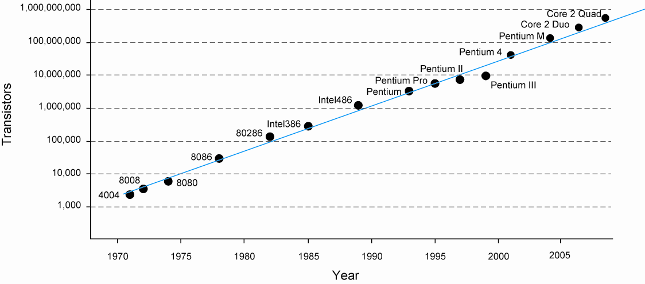
And Now…

Slide 12
Feature Size
Minimum feature size shrinking 30% every 2-3 years

Slide 13
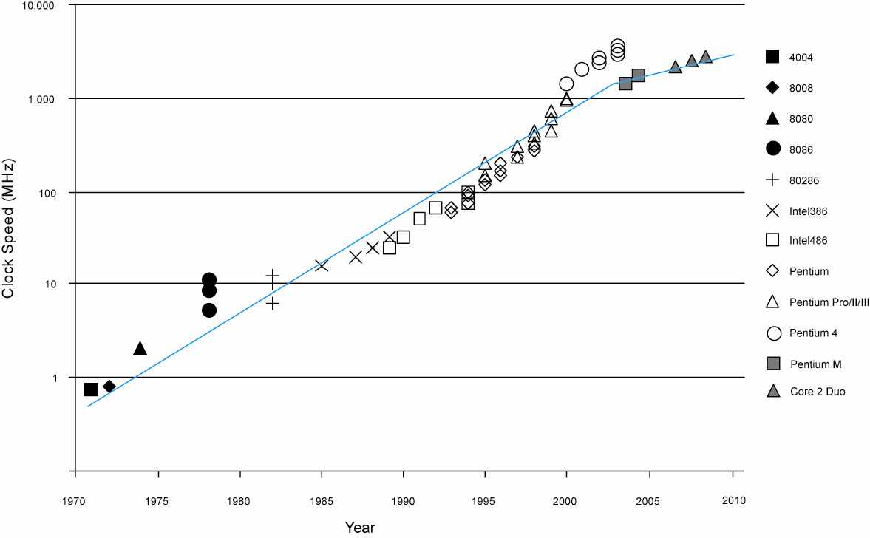
Corollaries
Many other factors grow exponentially
Ex: clock frequency, processor performance

Slide 14
CMOS Gate Design
Activity:
Sketch a 4-input CMOS NOR gate

Slide 15
Complementary CMOS
Complementary CMOS logic gates
nMOS pull-down network
pMOS pull-up network
a.k.a. static CMOS
 | Pull-up OFF | Pull-up ON
Pull-down OFF | Z (float) | 1
Pull-down ON | 0 | X (crowbar)

Slide 16
Series and Parallel
nMOS: 1 = ON
pMOS: 0 = ON
Series: both must be ON
Parallel: either can be ON

Slide 17
Conduction Complement
Complementary CMOS gates always produce 0 or 1
Ex: NAND gate
Series nMOS: Y=0 when both inputs are 1
Thus Y=1 when either input is 0
Requires parallel pMOS
Rule of Conduction Complements
Pull-up network is complement of pull-down
Parallel -> series, series -> parallel
Notes:
Không tính bù: OR: Song song
AND: Nối tiếp

Slide 18
Compound Gates
Compound gates can do any inverting function
Ex:

Slide 19
Example: O3AI

Slide 20
Signal Strength
Strength of signal
How close it approximates ideal voltage source
V_{DD} and GND rails are strongest 1 and 0
nMOS pass strong 0
But degraded or weak 1
pMOS pass strong 1
But degraded or weak 0
Thus nMOS are best for pull-down network

Slide 21
Pass Transistors
Transistors can be used as switches

Slide 22
Transmission Gates
Pass transistors produce degraded outputs
Transmission gates pass both 0 and 1 well

Slide 23
Tristates
Tristate buffer produces Z when not enabled
EN | A | Y
0 | 0 | Z
0 | 1 | Z
1 | 0 | 0
1 | 1 | 1

Slide 24
Nonrestoring Tristate
Transmission gate acts as tristate buffer
Only two transistors
But nonrestoring
Noise on A is passed on to Y

Slide 25
Tristate Inverter
Tristate inverter produces restored output
Violates conduction complement rule
Because we want a Z output

Slide 26
HET

Slide 27
BÀI TẬP
Câu 1: AOI22? Quy tắc viết theo dạng này
Câu 2:

Slide 28
Multiplexers
2:1 multiplexer chooses between two inputs
S | D1 | D0 | Y
0 | X | 0 | 0
0 | X | 1 | 1
1 | 0 | X | 0
1 | 1 | X | 1

Slide 29
Gate-Level Mux Design
How many transistors are needed? 20

Slide 30
Transmission Gate Mux
Nonrestoring mux uses two transmission gates
Only 4 transistors

Slide 31
Inverting Mux
Inverting multiplexer
Use compound AOI22
Or pair of tristate inverters
Essentially the same thing
Noninverting multiplexer adds an inverter

Slide 32
4:1 Multiplexer
4:1 mux chooses one of 4 inputs using two selects
Two levels of 2:1 muxes
Or four tristates

Slide 33
D Latch
When CLK = 1, latch is transparent
D flows through to Q like a buffer
When CLK = 0, the latch is opaque
Q holds its old value independent of D
a.k.a. transparent latch or level-sensitive latch

Slide 34
D Latch Design
Multiplexer chooses D or old Q

Slide 35
D Latch Operation

Slide 36
D Flip-flop
When CLK rises, D is copied to Q
At all other times, Q holds its value
a.k.a. positive edge-triggered flip-flop, master-slave flip-flop

Slide 37
D Flip-flop Design
Built from master and slave D latches

Slide 38
D Flip-flop Operation

Slide 39
Race Condition
Back-to-back flops can malfunction from clock skew
Second flip-flop fires late
Sees first flip-flop change and captures its result
Called hold-time failure or race condition

Slide 40
Nonoverlapping Clocks
Nonoverlapping clocks can prevent races
As long as nonoverlap exceeds clock skew
We will use them in this class for safe design
Industry manages skew more carefully instead

Slide 41
Gate Layout
Layout can be very time consuming
Design gates to fit together nicely
Build a library of standard cells
Standard cell design methodology
V_{DD} and GND should abut (standard height)
Adjacent gates should satisfy design rules
nMOS at bottom and pMOS at top
All gates include well and substrate contacts

Slide 42
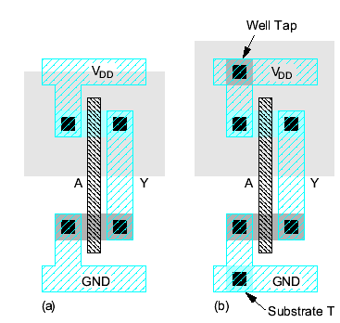
Example: Inverter

Slide 43
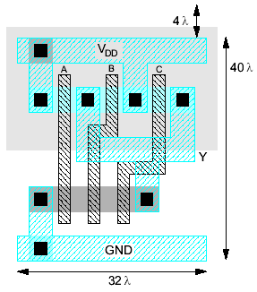
Example: NAND3
Horizontal N-diffusion and p-diffusion strips
Vertical polysilicon gates
Metal1 V_{DD} rail at top
Metal1 GND rail at bottom
32 λ by 40 λ

Slide 44
Stick Diagrams
Stick diagrams help plan layout quickly
Need not be to scale
Draw with color pencils or dry-erase markers

Slide 45
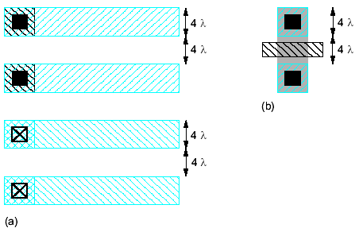
Wiring Tracks
A wiring track is the space required for a wire
4 λ width, 4 λ spacing from neighbor = 8 λ pitch
Transistors also consume one wiring track

Slide 46
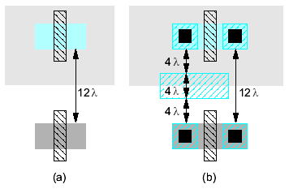
Well spacing
Wells must surround transistors by 6 λ
Implies 12 λ between opposite transistor flavors
Leaves room for one wire track

Slide 47
Area Estimation
Estimate area by counting wiring tracks
Multiply by 8 to express in λ

Slide 48
Example: O3AI
Sketch a stick diagram for O3AI and estimate area

